Slide 1
Goods Data Analysis
Bootcamp data science (T5):
Mohammed Al shehri.

Slide 2
Dataset
I have chosen a dataset that contains import and export information from 2014 until June 2021,
Such as date, country of export and imports, values of import and export.
The dataset contains more than 100K rows and 7 columns.

Slide 3
Process data:
Cleaning data:
Dropping rows using “df.dropna()” to remove rows containing NaN value(s) .
Remove unwanted countries code ( code that does not belong to any country).
Remove month from “time_ref” column.
Data preparing:
Rename countries code by country name ( using another CSV file ).

Slide 4
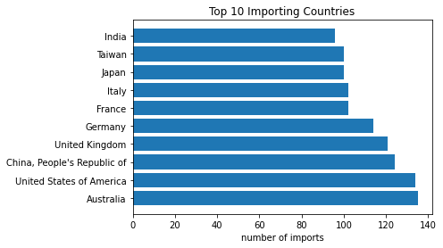
Top 10 importing countries:
1- in this slide my goal is to find the most imports country that I have in dataset:

Slide 5
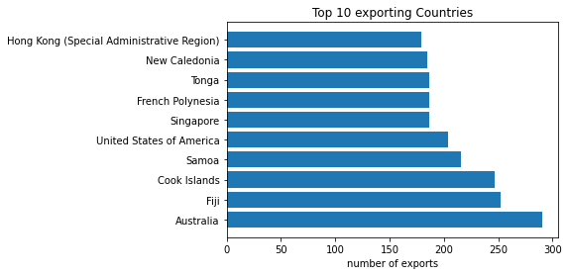
Top 10 exporting countries:
2- in this slide my aim in here is to find the most exports country that I have in dataset:

Slide 6
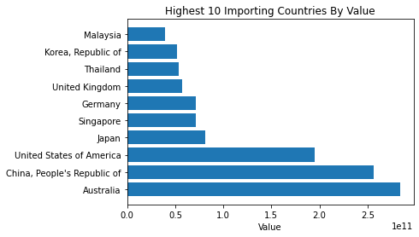
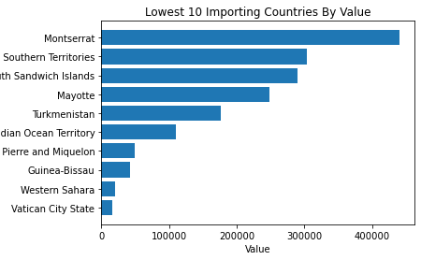
What are the highest and lowest importing countries ?
3 – in this slide my goal is highest and lowest importing countries that I have in dataset:

Slide 7
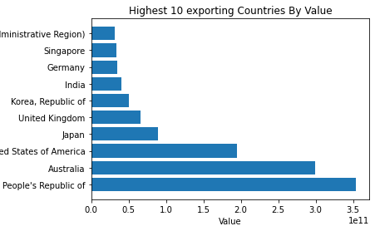
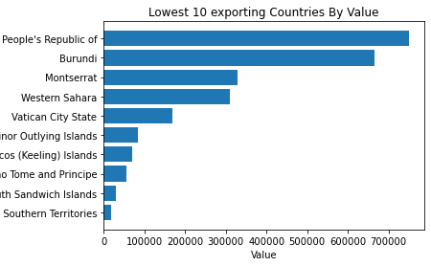
What are the highest and lowest exporting countries ?
4 - in this slide my goal is highest and lowest exporting countries that I have in dataset:

Slide 8
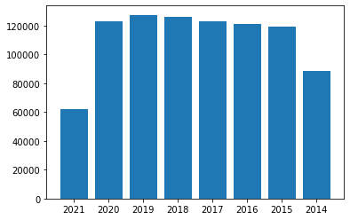
Number Of Imports In Years:
5- in this slide my goal is to see the number of imports in years that I have in dataset:

Slide 9
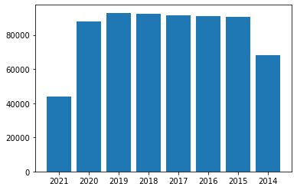
Number Of Exports In Years
6- in this slide my goal is to see the number of export in years that I have in dataset:
:

Slide 10
Tools
1- Python.
2- Pandas.
3- Numpy.
4- Matplotlip.

Slide 11

Thanks

